Slide 1
The Case Of The Vanishing Scallops

Slide 2
Aim: How can we use the scientific method to solve the scallop mystery?
Do Now: With your group, brainstorm:
What are the steps of the scientific method?
What is the purpose of the scientific method?
What do you think is the most important step of the scientific method?
Notes:
There are many versions of the scientific method, choose the one your students are most familiar with.
Question 3 of course has no real answer, the intention is to stimulate discussion.

Slide 3
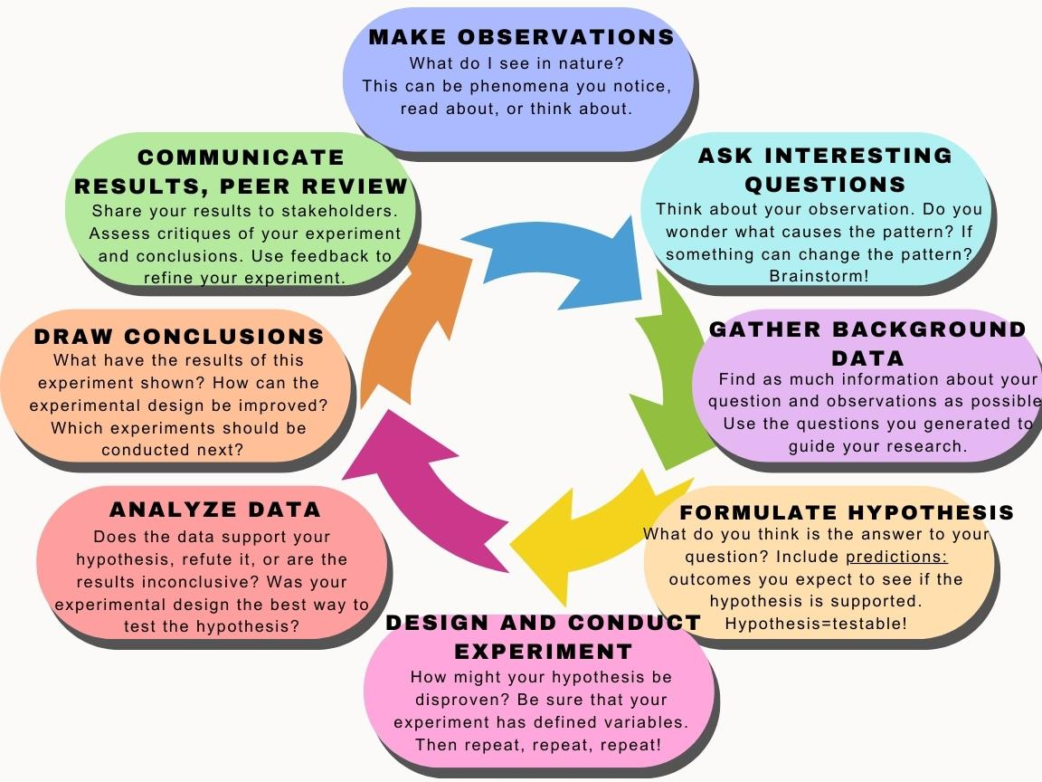
The Scientific Method
Notes:
Review the steps of the scientific method with the class.
Allot extra time as needed, depending on the students’ proficiency.
Ask:
Why is this represented as a cycle?

Slide 4
The Scientific Method
Notes:
Previously we focused on the first two steps of this process, as we try our hand at investigating a mysterious phenomenon that happened recently in coastal waters.

Slide 5
The Scientific Method
✔
✔
Notes:
Now we are going to focus on the next step of the process: gathering data.
Ask students: Why do you think it’s important to do research about what is already know, before conducting an experiment?
Some possible answers:
To see if experiment has already been conducted.
To find out previous experimental procedures that might be applicable
To stimulate ideas about variables that may need to be controlled

Slide 6
Our task:
Over the next few class sessions, you will be designing a scientific experiment to solve an aspect of the the scallop mystery, for example:
-What is causing the die-off?
-How can it be prevented in the future?
-How is this impacting the surrounding ecosystem?

Slide 7
Scientific Method Step 3:
Gather Background Information
Select one of the questions you generated yesterday that will help you solve the mystery.
Use trusted sources to find answers.
(This is often called a literature review, although ours is abbreviated)
Notes:
This will take a full class period or more depending on the level of research you want the students to conduct.
This is an excellent opportunity to review trusted sources, scholarly journals, citations, and more, if time and teacher inclination allow.
This would also work well as a group project.

Slide 8
The Scientific Method
✔
✔
✔
Notes:
Review the conventions of hypotheses. Often students have been taught a specific format for hypotheses, for example:
“I think that…”
“If _________, then _________”

Slide 9
Scientific Method Step 4:
Formulate Hypothesis
Based on what they’ve read, students will create a testable hypothesis to explain why the scallops are vanishing.
Hypotheses must include predictions: what will be an observable results during this experiment if their hypothesis is correct?

Slide 10
Hypothesis vs. Prediction examples:
Hypothesis
Prediction
Plant growth depends on amount of sunlight.
The plants grown in sunlight during the experiment will be taller than those grown in the shade.
Climate change causes coral bleaching.
Corals exposed to warmer temperatures will bleach at a higher rate than those exposed to control temperatures.
Notes:
This is a good opportunity to review independent vs dependent variables

Slide 11
The Scientific Method
✔
✔
✔
✔

Slide 12
Scientific Method Step 5:
Design Experiment
Students will design an experiment, with an unlimited budget, to test their hypothesis.

Slide 13
The Scientific Method
✔
✔
✔
✔
✔

Slide 14
The Case Of The Vanishing Scallops

