Slide 1
The Case Of The Vanishing Scallops

Slide 2
Part 1

Slide 3
Aim: How can we solve “The Case of the Vanishing Scallops”?
Do Now: Plot the data shown on your worksheet.
What are THREE things you notice based on the information from the graph?

Slide 4
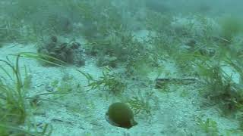
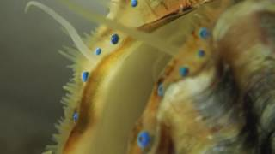
Our subject: Bay Scallops!
Argopecten irradians
Notes:
Share some interesting facts about scallops to stimulate students’ curiosity.
For example, they are among few bivalves that swim, and they have ~200 beautiful blue eyes

Slide 5
Think more deeply about the data:
2. What does “scallop harvest” mean? Who harvests scallops? For what purpose?
3. Does a changing scallop harvest necessarily imply a decline in the scallop population? What else, besides declining population, could result in smaller harvests?
4. What additional information would you need to determine if lower scallop harvest were due to declining populations of scallops?
Notes:
As a class, students can brainstorm about the possible answers to these questions. They may think about other reasons why baymen harvest fewer scallops: new laws/ regulations? Lack of demand? Lower fishing effort?
The goal here is that students learn not to take information at face value, but instead think more deeply and critically about the data.

Slide 6
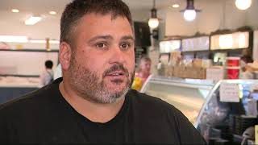
Scientific Method Step 1:
Make Observations/ Identify the Problem
What are people noticing about scallop populations?
Why does this matter?
Notes:
Students should understand that the scallop population is decreasing.
Ask students to brainstorm multiple impacts of the die-off: the video focuses on human impacts such as the economy, jobs, tourism.
Guide students toward environmental impacts as well: food sources for predators, removal of particulate matter, etc…

Slide 7
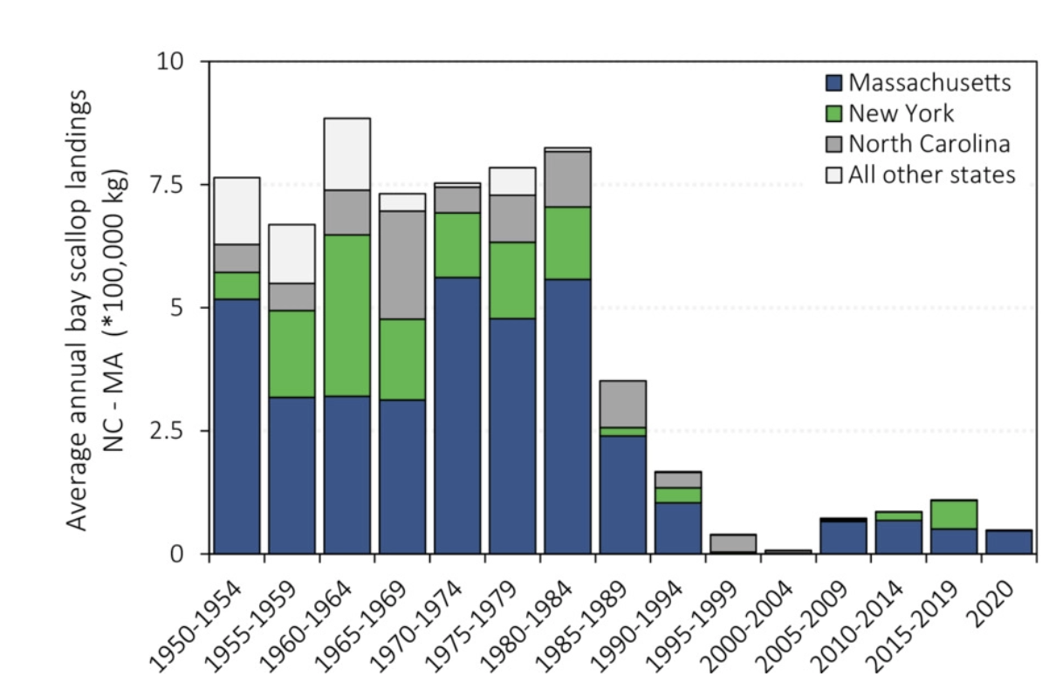
Notes:
Ask students to examine data table.
What is labelled on each axis?
What do the different colors indicate?
What trends do they notice?
Is it true for all states?
Source: https://scienceline.org/2023/08/long-islands-scallops-are-dying-out-scientists-are-hunting-for-answers/

Slide 8

Ask Interesting Questions
Think about what you just watched.
Generate a list of questions about the scallop die-off,
consider at least 1 for each of the traditional question words
Notes:
This can be challenging for students.
It is important to let them productively struggle to create interesting questions about this problem.
Students will be inclined toward simplistic questions at first, ex “What is a scallop?” “Who made the video?”
Continue to push them towards questions focused on the die-off
Examples:
Who are their predators? Has the predator population changed?
What do they eat? Have food resources changed?
What type of environment do they like to live in? Has that changed?
What aspects of water quality do they prefer? Has any of that changed?

Slide 9
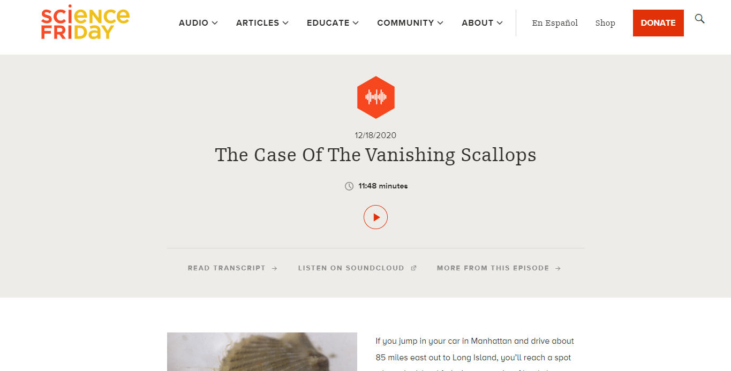
How have researchers tried to address this issue?
The Case Of The Vanishing Scallops

Slide 10
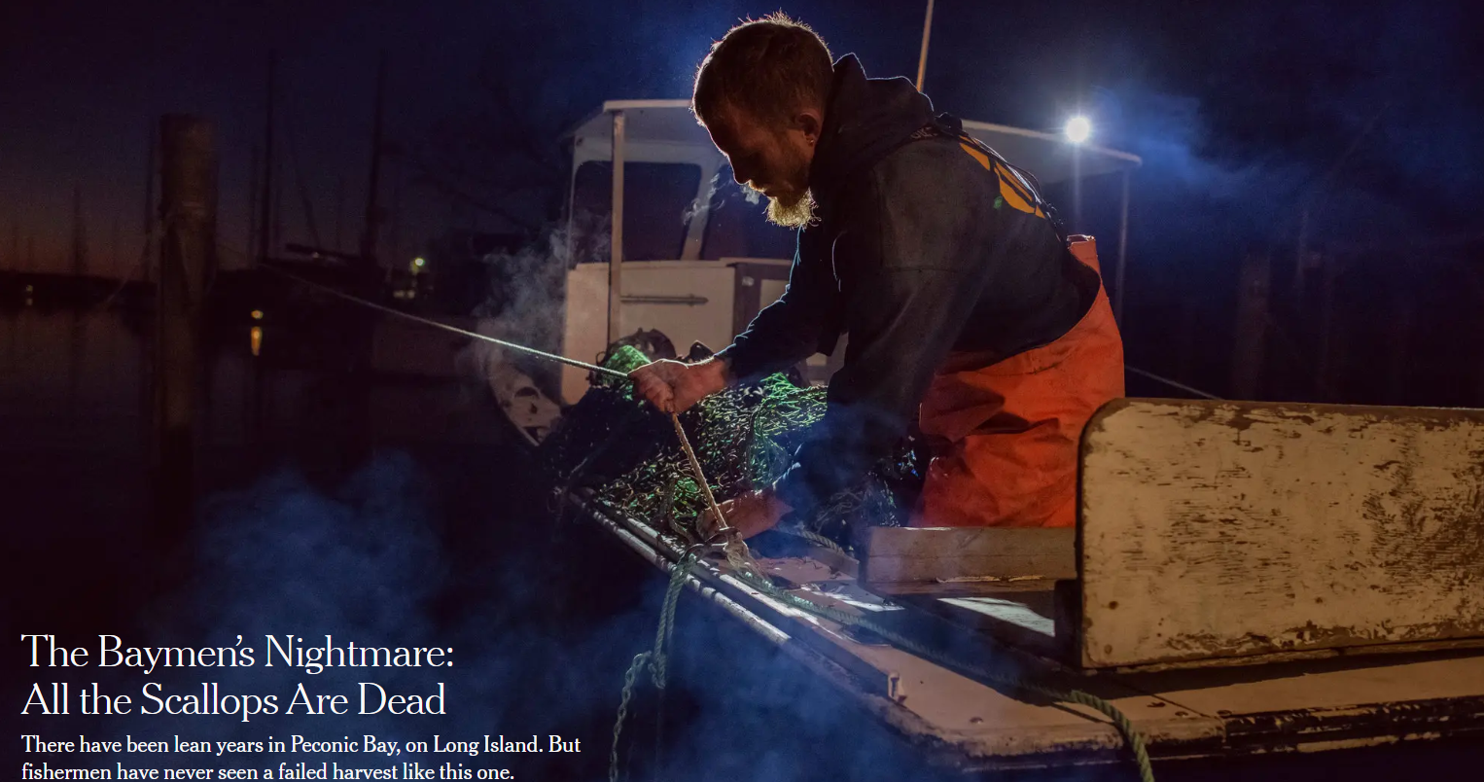
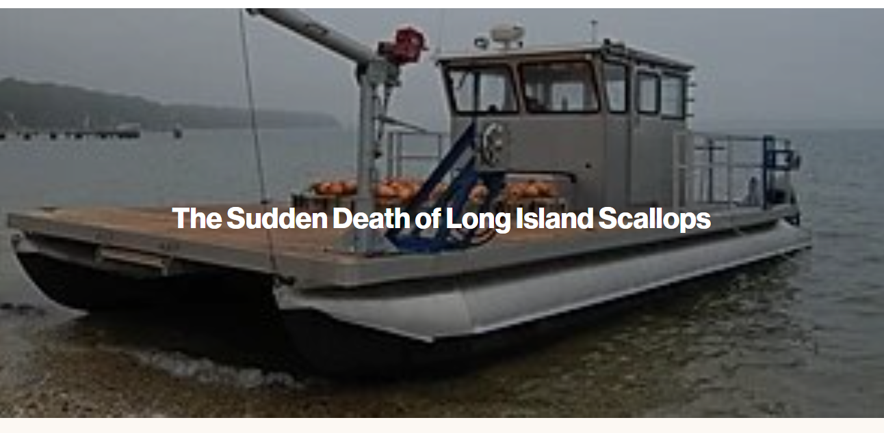
Supplemental Reading

