Slide 1
Chemistry of Ocean Acidification

Slide 2
Activity 1
Combustion

Slide 3
Aim: How can we demonstrate how the combustion of fossil fuels changes the ocean’s pH?
Do Now: What do you think combustion means?

Slide 4
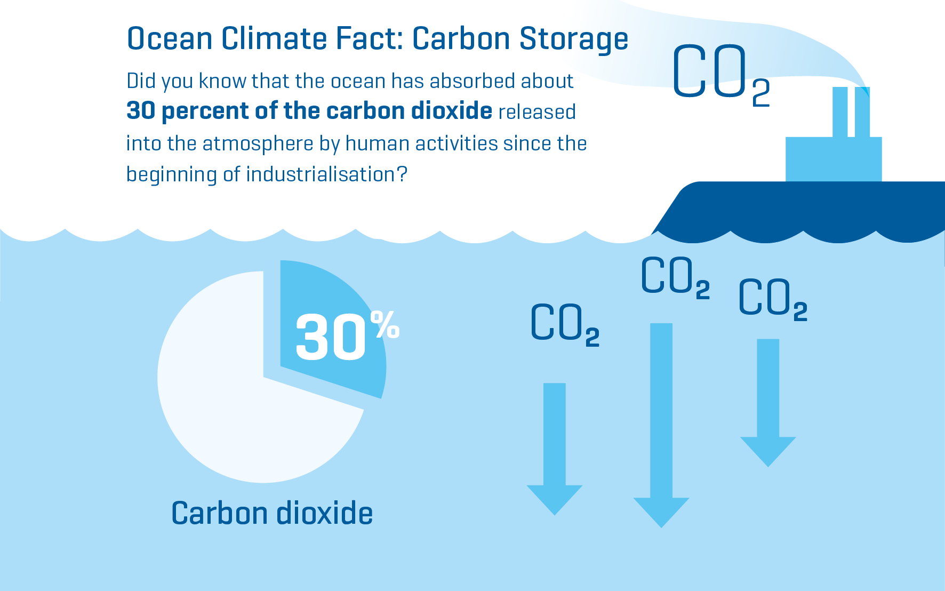
Notes:
Now, an important ecosystem service of the ocean is the sequestering of CO2, and while the ocean has built in buffering capacities, the increasing atmospheric CO2 is overtaxing the system.
Image source: https://www.geomar.de/en/discover/ocean-for-climate-protection

Slide 5
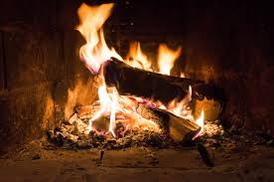
Combustion
Burning organic material in the presence of oxygen to produce heat energy, CO₂, and water.
Examples: wood, paper, and fossil fuels (natural gas, oil, or coal).

Slide 6
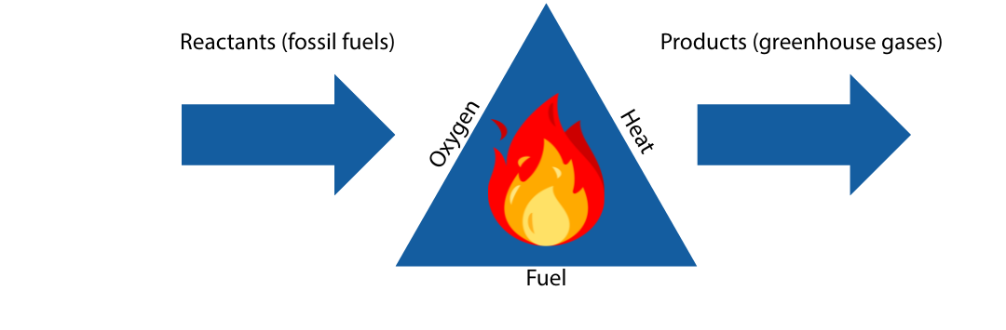
Carbon Dioxide is released during combustion and fossil fuel burning.

Slide 7
How can we design an experiment to show that combustion releases CO₂?
Notes:
Experiment adapted from NJ Sea Grant: https://njseagrant.org/wp-content/uploads/2014/02/Ocean-Acidification.pdf

Slide 8
Follow along!
1. Label your two test tubes “air” and “combustion.”
2. Pour approximately 5 mL of dilute BTB into the test tube labeled “air.” Cap the test tube and shake for approximately 10 seconds. Observe the BTB solution.
3. Record: Do you notice any color change?

Slide 9
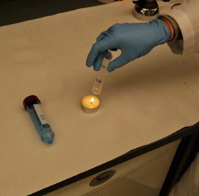
Follow along!
4. Now, light the candle.
5. Uncap the test tube labeled “combustion” and hold it upside down above the flame for 10 seconds.
6. While the test tube is still upside down, cap the test tube.

Slide 10
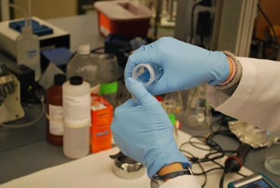
Follow along!
7. Now we will try to add BTB without releasing the combusted air from the test tube.
Use your thumb to keep the top covered. Move thumb slightly and quickly pour approximately 5 mL of dilute BTB solution into the test tube.
8. Recap the “combustion” test tube and shake for approximately 10 seconds.

Slide 11
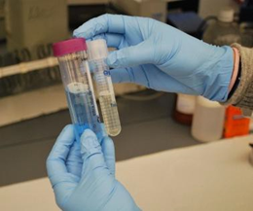
Follow along!
9. Compare the BTB in the test tube labeled “air” to the BTB in the test tube labeled “combustion.” Record your observations in your lab notebook.

Slide 12
Talk it out!
Discuss the conclusion questions with your lab group.
Then respond individually ( your own words) on the lab sheet.

Slide 13
Activity 2
Lego Build a Shell

Slide 14
Aim: Why would smoke in the atmosphere cause a mollusk to have a thinner shell?
Do Now: What do you think? How can combustion eventually lead to changes in the physiology of organisms?

Slide 15
Let’s recap!
Turn and talk to a partner:
How does dissolving CO₂ into water change the pH?

Slide 16
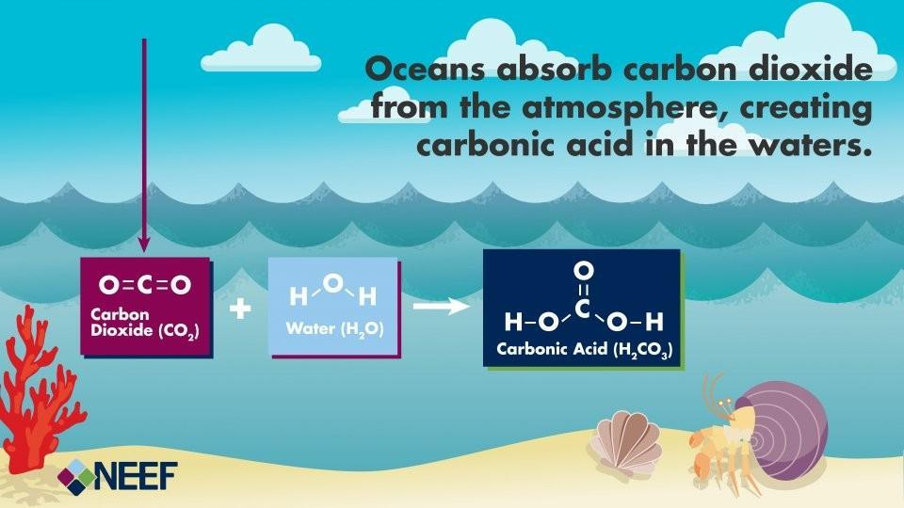
How can CO₂ create change in the ocean’s pH?
Notes:
So what’s the relationship between CO2 and pH?
Water plus carbon dioxide combine to produce carbonic acid.
Image credit:
https://www.neefusa.org/resource/ocean-acidification-infographic

Slide 17
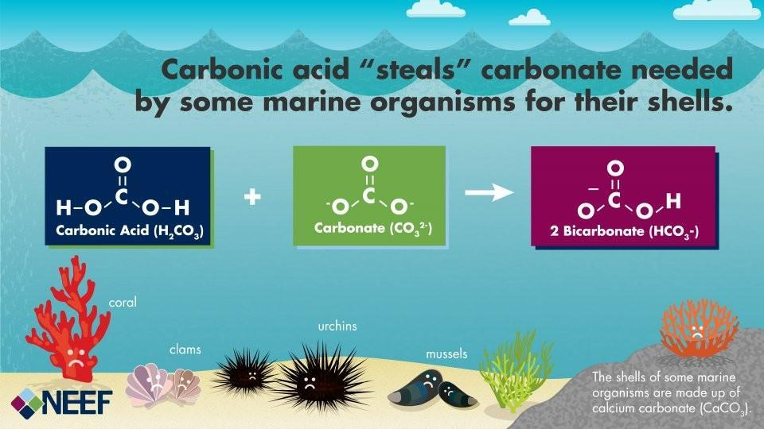
How does carbonic acid create changes in ocean ecosystems?
Notes:
Carbonic acid is a weak acid, so what’s the big deal?
Well it combines with Carbonate, which is typically used by shelled animals to make calcium carbonate.
Image credit:
https://www.neefusa.org/resource/ocean-acidification-infographic

Slide 18
Let’s play a game!
Today we’re going to play a game with LEGOs, to show how increased acidity “steals” carbonate that organisms need for their shells!

Slide 19
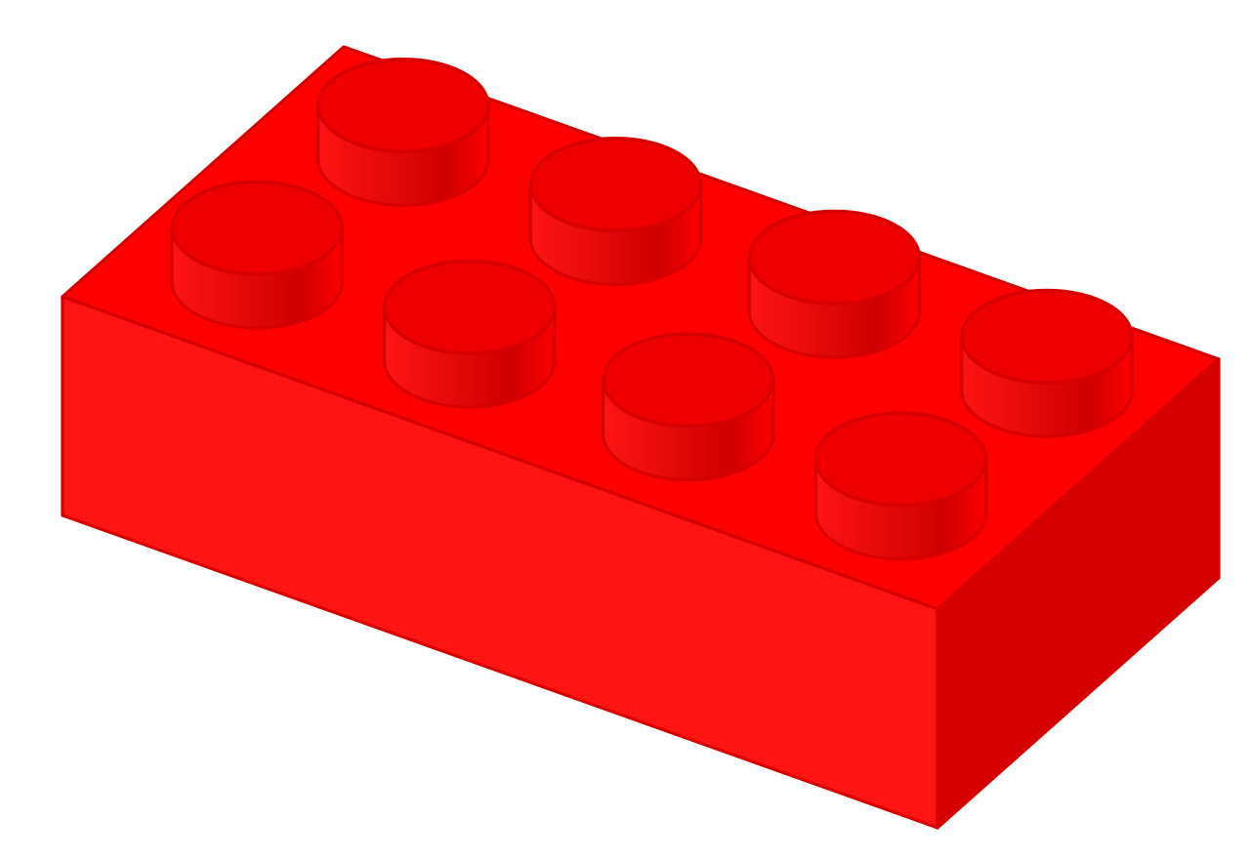
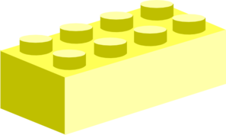
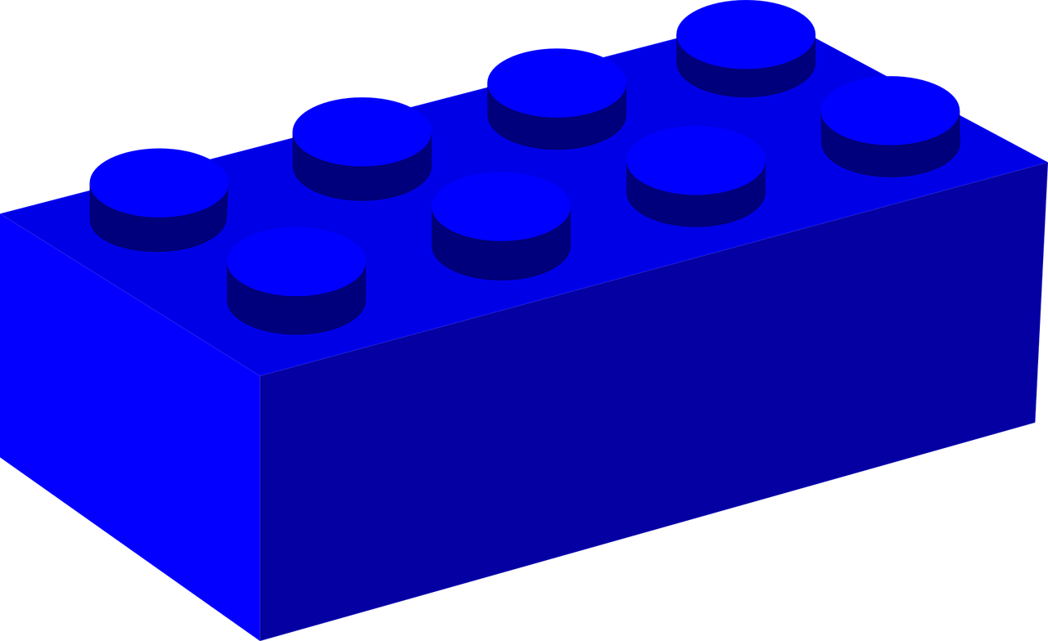

Each LEGO represents a molecule!
Which one represents an acid?
Lego | Ion/ molecule
 | H⁺ (Hydrogen) *amount determines pH of seawater
 | CO₃ (Carbonate)
 | Ca⁺ (Calcium)
 | CaCO₃ (Calcium Carbonate)
 | HCO₃⁻ (Bicarbonate)

Slide 20
Game Play!
Your group has 60 seconds to take out ONE lego at a time WITHOUT PEEKING!
Each LEGO must be paired with a free one you have selected already. If it can’t be paired, you must wait until your next turn to draw again.
Possible pairs | NOT allowed

Slide 21
Round 1 (Pre-Industrial Era):
Disconnect and place 12 yellow, 12 blue, and 2 red Legos in a bag.
Set timer for 60 seconds, proceed following rules above.
Record results in data table.

Slide 22
Round 2 (Industrial Era):
Disconnect and place 12 yellow, 12 blue, and 3 red Legos in a bag.
Set timer for 60 seconds, proceed following rules above.
Record results in data table.

Slide 23
Round 3 (Future scenario):
Disconnect and place 12 yellow, 12 blue, and 6 red Legos in a bag.
Set timer for 60 seconds, proceed following rules above.
Record results in data table.

Slide 24
Talk it out!
Discuss the conclusion questions with your lab group.
Then respond individually (your own words) on the lab sheet.

